Slide 1
Item/doc 6.1 – Work Programme
Item/Doc 6.2 – Subsidiary Bodies
Third Session of the Infrastructure Commission
(INFCOM-3, 15-19 April 2024)
J. Hasegawa/Secretariat
15 April 2024

Slide 2
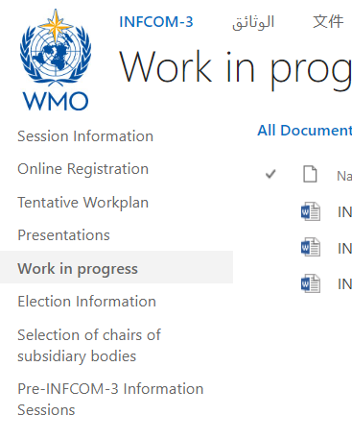
Content
Agenda item 6.1, Doc 6.1: work programme for the next intersessional period
Agenda item 6.2, Doc 6.2: subsidiary bodies for the next intersessional period – Work in Progress available

Slide 3
1. Work programme of the Commission for the next inter-sessional period
Doc 6.1, INF 6.1

Slide 4
Work programme – Doc 6.1
Doc 6.1 includes draft Resolution 6.1/1 to adopt the work programme (work plan) of the Commission for the next intersessional period.
Work programme consists of the list of activities and corresponding deliverables in three groups:
Development, maintenance and monitoring activities in 2024-2025 (e.g., update manuals and guides, compliance monitoring)
Specific elements/focus areas from the Strategic Plan 2024-2027 under each relevant Strategic Objective (SO) in 2024-2025
Explore new initiatives to be promoted in the next intersessional period (2025-2026)

Slide 5
Work programme – Doc 6.1
Management Group is requested to:
(1) To continue to maintain, update and to regularly review and reprioritize the activities and deliverables, including the minor and moderate modifications to the activities of the WMO Plan of Action for Hydrology 2023-2030, and to submit necessary deliverables to the future sessions;
(2) To review the approach taken to define the work programme and propose, if necessary, an improved approach to define and update the work programme and to monitor and evaluate its implementation, considering the programme description to be adopted, and the review of the WMO programme-based approach and related planning, programming and budgeting processes conducted by the Executive Council;

Slide 6
2. Subsidiary bodies of the Commission for the next inter-sessional period
Doc 6.2, INF 6.2

Slide 7
Subsidiary bodies – Doc 6.2
Draft Resolution 6.2/1
Establish SCs, AGs and SGs, and coordinators
Draft Decision 6.2/1
Endorse chairs of SCs, AGs and SGs, and coordinators
Draft Decision 6.2/2
Endorse the composition of the Management Group

Slide 8
Draft Resolution 6.2/1
Standing Committees
Standing Committee on Earth Observing Systems and Monitoring Networks (SC-ON);
Study Groups
Study Group on Environmental Sustainability (SG-EnvS); [Doc 7.3]
Advisory Group on the Global Cryosphere Watch (AG-GCW);
Coordinators
Standing Committee on Measurements, Instrumentation and Traceability (SC-MINT);
Standing Committee on Information Management and Technology (SC-IMT);
Standing Committee on the WMO Integrated Processing and Prediction System (SC-WIPPS);
Advisory Groups
Study Group on Future Data Infrastructure (SG-FIT); [Doc 8.3(5)]
Study Group on Centres Assessment, Designation and Compliance Review (SG-ADCR); [Doc 8.5(4)]
Advisory Group on the Ocean (AG-Ocean);
Advisory Group on Hydrology (AG-Hydro); [Doc 8.5(3)]
Advisory Group on the Global Greenhouse Gas Watch (AG-G3W); [Doc 7.2]
Coordinator on the implementation of the WMO Unified Data Policy (C-DATA);
Coordinator on capacity development (C-CD);

Slide 9
Standing Committees
Working on standard setting and implementation monitoring of WIGOS, WIS and WIPPS
SC-ON
WIGOS - networks
SC-MINT
WIGOS - measurements
SC-IMT
WIS
SC-WIPPS
WIPPS
AG-Ocean
AG-GCW (Global Cryosphere Watch)
Advisory Groups
Addressing requirements and engaging with community specific to Earth system domain
AG-Hydrology
AG-G3W (Global Greenhouse Gas Watch)
Space Weather
Satellite/space agencies
C-Data (implementation of the Unified Data Policy)
C-CD (Capacity Development)
SG-EnvS (Environmental Sustainability)
SG-FIT (Future Data Infrastructure)
Study Groups
Addressing specific
Cg and EC requests
SG-ADCR (Centres Assessment, Designation and Compliance Review)

Slide 10
Draft Resolution 6.2/1
Requests to the president on follow-up actions:
Selection of experts and establishment of Expert Teams and Task Teams
Appointment of representatives and focal points on SERCOM, RB, JCB and the EC panels and inform Members
Outstanding items to be tasked to the president:
Working and coordination structure/mechanism for space weather activities guided by the Four-year Plan for WMO Activities related to Space Weather 2024-2027 [Doc 8.5(2)]
Working structure for coordination of satellite related activities and for engagement with partner space agencies through CGMS and CEOS [Doc 9.1]
Working structure for development of a WMO Standard Vocabulary
Working structure for collaborating with SERCOM and UNESCO on guidance materials in the hydrology domain
Governance of AG-Ocean, including its ToR: to more effectively represent and advise infrastructure-related bodies under JCB, in consultation with SERCOM – additions in WiP by USA

Slide 11
Draft Decision 6.2/1
Decision to endorse chairs and vice-chairs of standing committees, study groups and advisory groups and coordinators
Standing Committee on Earth Observing Systems and Monitoring Networks (SC-ON);
Standing Committee on Measurements, Instrumentation and Traceability (SC-MINT);
Standing Committee on Information Management and Technology (SC-IMT);
Standing Committee on the WMO Integrated Processing and Prediction System (SC-WIPPS);
Study Group on Environmental Sustainability (SG-EnvS);
Study Group on Future Data Infrastructure (SG-FIT)
Study Group on Centres Assessment, Designation and Compliance Review (SG-ADCR);
Advisory Group on the Global Cryosphere Watch (AG-GCW);
Advisory Group on the Ocean (AG-Ocean);
Advisory Group on Hydrology (AG-Hydro);
Advisory Group on the Global Greenhouse Gas Watch (AG-G3W);
Coordinator on the implementation of the WMO Unified Data Policy (C-DATA);
Coordinator on capacity development (C-CD);

Slide 12
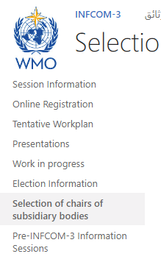
Draft Decision 6.2/1 – process
PRs and experts are invited to make nomination of candidates of chairs and vice-chairs of standing committees, study groups and advisory groups.
Through the circular letter: 01543/2024/I/Technical Experts
The proposal will be made by the elected officers (president and vice-presidents), to the plenary session of Day 5, for the Commission’s decision, based on the above nominations.
Information on the nomination is available on the INFCOM-3 website - INFCOM-3 - Selection of chairs of subsidiary bodies (wmo.int)
Note: Election will be only for officers; c.f. Doc 12

Slide 13
Draft Decision 6.2/2
Decision to endorse the composition of the Management Group of the Commission for the next intersessional period
Elected officers: president and up to three co-vice-president(s),
Chair, co-chairs, vice-chair, co-vice-chairs of the standing committees, study groups and advisory groups [decided through draft Decision 6.2/1],
Coordinators on Capacity Development and the implementation of the WMO Unified Data Policy,
One representative from each of the six regional associations Working Groups/Committees on Infrastructure (if not already included under (b) and (c) above) based on agreement between the president of each regional association and the president,
Chair of the Steering Committee of GCOS, as an ex-officio member,
Chair of the Steering Committee of GOOS, as an ex-officio member,
Representative of CGMS, as an ex-officio member;
INFCOM leaders
Coordination on cross-systems topics
Collaboration with Regions
Partner engagement
Note: ToR of the Management Group is defined in Annex III of the RoP-TC (WMO-NO. 1240)

Slide 14
Thank you.
^{wmo.int}

